Slide 1

England Premier League
Match Outcome Prediction

Slide 2

The problem
The Opportunity
If betting companies have inaccurate probability to predict soccer match outcomes, they will lose a lot of money
The industry is worth $7 billion a year

Slide 3

Mission statement:
Generate more accurate model to predict probability of EPL match outcome.

Slide 4
Workflow
Part 3
Part 2
Part 1
Prediction
Model Selection
Data Collection &
Data Organization

Slide 5

Data Collection
EPL Match Data:
Source: football-data.co.uk
Time Range: seasons 2008 to 2015; 380 matches each season
Attributes: scores, lineup, team formation, goal types, corner, cross, cards etc...
Players' information:
Source: EA Sports' FIFA games website
Overall rating

Slide 6
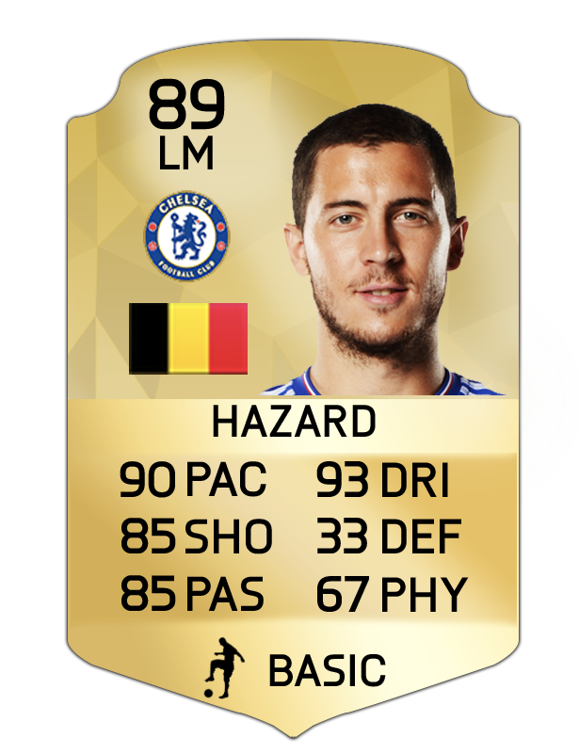

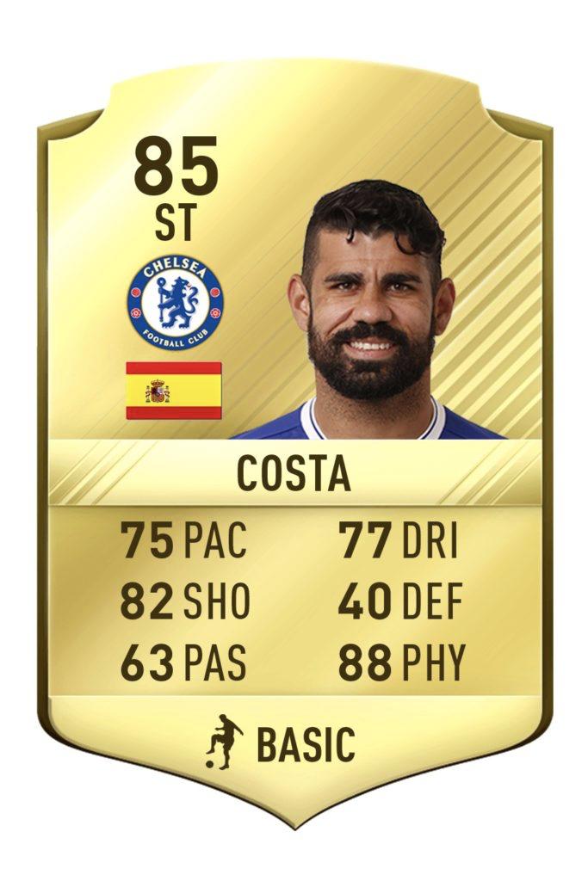
Data Organization
Clean Data
Calculate Team Skill Scores
Generate Response Variables
Extract Values
Determine Home Advantage/Luck vs Skill
Delete rows with missing values
Delete columns with identical values
Determine GoalKeeper, Front, Middle and Back by player’s Y-coordinates
Calculate average scores for each area
Goal Difference
Match Outcome (win, draw, loss)
Step 1 |  | Step 2 |  |  | Step 3 |  | Step 4 |  | Step 5
Extract
# of red cards, shoot on points, corner points, etc.
from HTML code
Average difference between home scores and away scores
Ignore luck here because it will have same effects on both teams

Slide 7
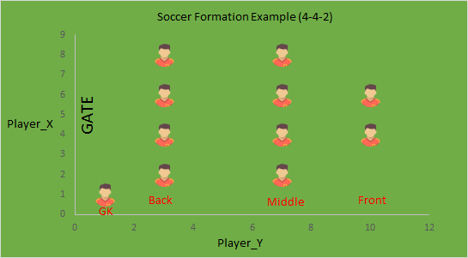
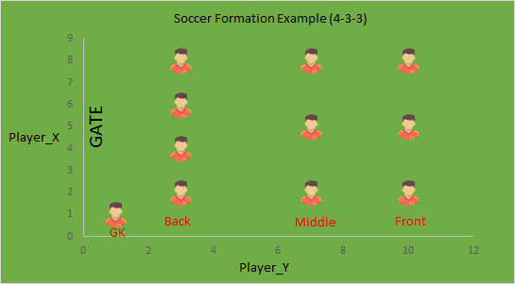
Team Skill Scores

Slide 8
Data Organization
Clean Data
Calculate Team Skill Scores
Generate Response Variables
Extract Values
Determine Home Advantage/Luck vs Skill
Delete rows with missing values
Delete columns with identical values
Determine GoalKeeper, Front, Middle and Back by player’s Y-coordinates
Calculate average scores for each area
Goal Difference
Match Outcome (win, draw, loss)
Step 1 |  | Step 2 |  |  | Step 3 |  | Step 4 |  | Step 5
Extract
# of red cards, shoot on points, corner points, etc.
from HTML code
Average difference between home scores and away scores
Ignore luck here because it will have same effects on both teams

Slide 9
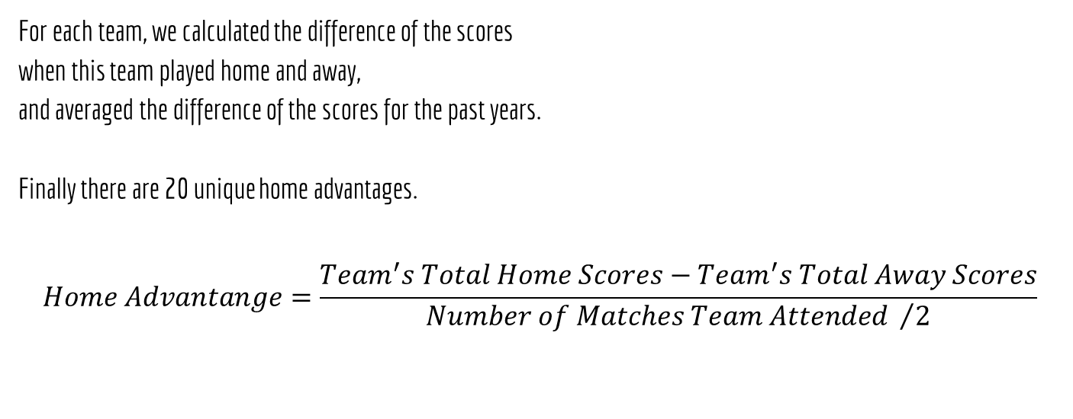
Home Advantage

Slide 10
Data Organization
Clean Data
Calculate Team Skill Scores
Generate Response Variables
Extract Values
Determine Home Advantage/Luck vs Skill
Delete rows with missing values
Delete columns with identical values
Determine GoalKeeper, Front, Middle and Back by player’s Y-coordinates
Calculate average scores for each area
Goal Difference
Match Outcome (win, draw, loss)
Step 1 |  | Step 2 |  |  | Step 3 |  | Step 4 |  | Step 5
Extract
# of red cards, shoot on points, corner points, etc.
from HTML code
Average difference between home scores and away scores
Ignore luck here because it will have same effects on both teams

Slide 11
Attributes Description
Features
Response Variables
RedCard (Home/Away)
ShotOn (H/A)
ShotOff (H/A)
Corner (H/A)
Cross (H/A)
GK_AVG (H/A)
Back_AVG (H/A)
Middle_AVG (H/A)
Front_AVG (H/A)
Home_Adv
Red Card Amount
Shot On Target Quantity
Shot Off Target Quantity
Corner Quantity
Cross Quantity
Goal Keeper's Rating
Defenders' Average Rating
Midfielders' Average Rating
Strikers' Average Rating
Home Advantage
Goal Difference
Match Outcome - Win, Draw, loss

Slide 12

Model Selection
Regression + Classification

Slide 13

Models
Method/Prediction | Prediction Type | Error Rate | k
Linear Regression | Goal Difference | 2.427582 | ---
Linear Regression + Forward Subset Selection | Goal Difference | 2.430666 | ---
PLS | Goal Difference | 2.422217 | ---
PCR | Goal Difference | 2.505872 | ---
Multinomial Logistic Regression | Match Outcome | 0.4534884 | 4
Multinomial Logistic Regression + Lasso | Match Outcome | 0.433195 | 4
LDA | Match Outcome | 0.3372093 | 2
KNN | Match Outcome | 0.6226964 | 4
Decision Tree | Match Outcome | 0.4622093 | 2
Poisson Distribution | Score-Line Probability | 0.5625 | ---

Slide 14
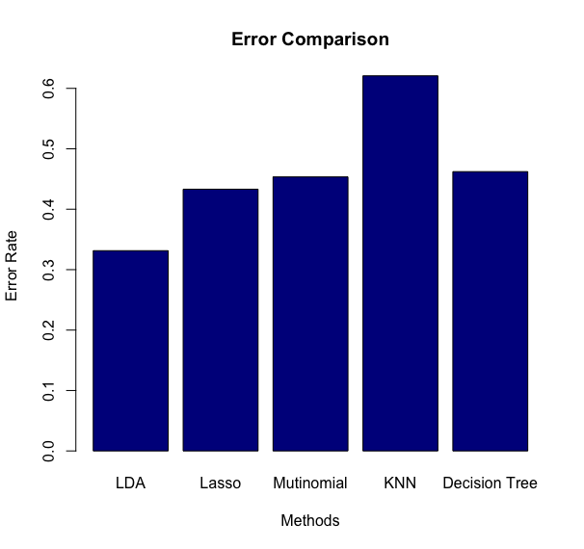
Model Selection-Match Outcome
Multinomial Logistic Regression
Multinomial Logistic Regression + Lasso
LDA
KNN
Decision Tree
Best Model:
LDA ( error rate = 33.72%)
[ comparing to random guess
error rate = 66.67% ]

Slide 15
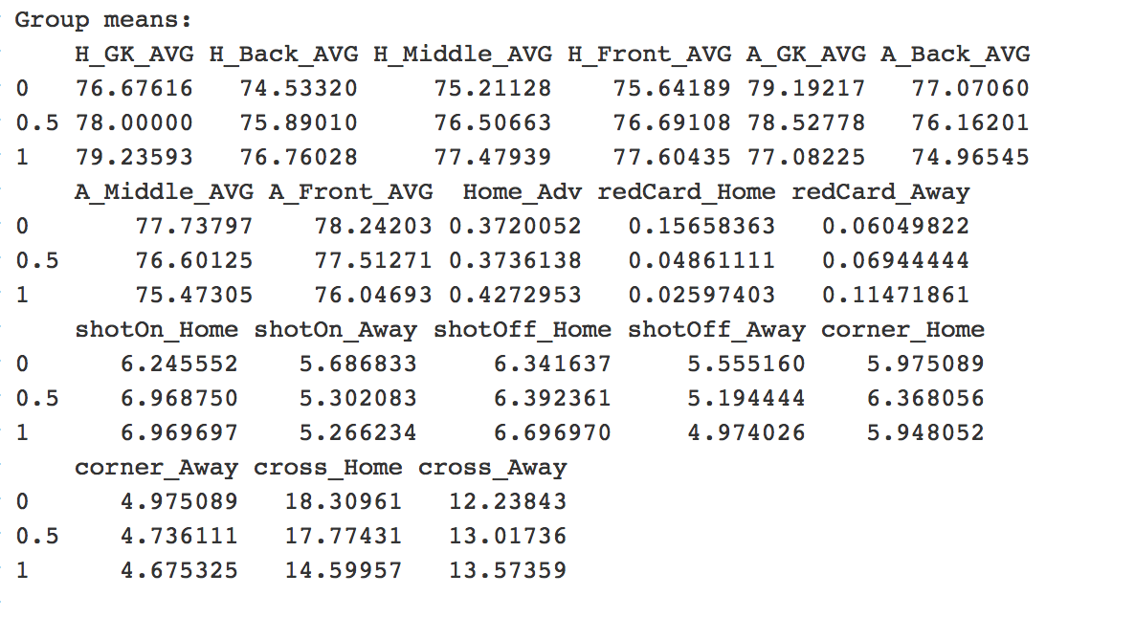
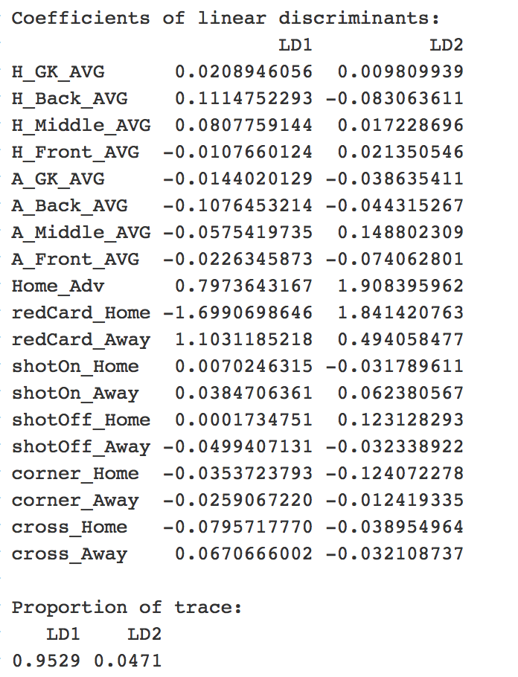
LDA Result

Slide 16
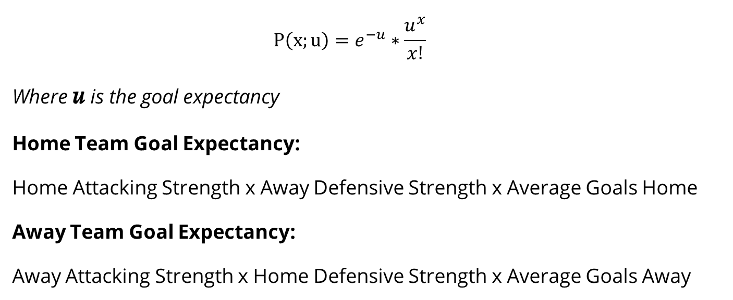
Poisson Distribution: Predict the scoreline probability

Slide 17
Poisson Distribution: Predict the scoreline probability
E.g. Poisson Distribution for West Ham vs.Tottenham (which will be held at May 5th 2017):
 | 0 | 1 | 2 | 3 | 4 | 5 | 6
West Ham | 52.86% | 33.70% | 10.74% | 2.28% | 0.36% | 0.05% | 0.00%
Tottenham | 14.43% | 27.93% | 27.04% | 17.45% | 8.45% | 3.27% | 1.11%
We assume both scores are independent, then the expected score will be 0:1 with probability of (0.5286*0.2793)=14.76%- pairing the most probable outcomes for each team.

Slide 18

Prediction
Match Outcome
Scoreline Probability

Slide 19




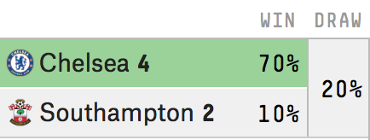
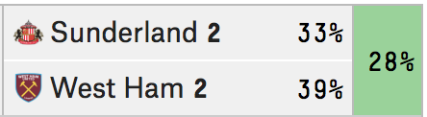

Predict Match Outcome using LDA
Actual Result
April 25, 2017
WIN
April 15, 2017
WIN
Chelsea
67.68%
DRAW
DRAW
Sunderland
34.98%
26.71%
31.29%
Southampton
5.61%
West Ham United
33.73%

Slide 20
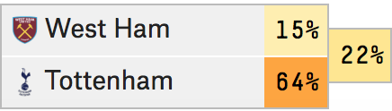

Predict Scoreline Probability using Poisson Distribution
0
14.77%
1
0
14.29%
2
West Ham vs. Tottenham
( 5th May 2017)
1
9.41%
1
0
9.22%
3
1
9.11%
2
0
7.63%
0
West Ham Win: 11.36%; Draw: 20.37%; Loss: 68.27%

Slide 21
Probability
Profit comes from...
Odds
Profit
Odds=1/Probability
Final Odds=Odds/(1+margin)
Probability Accuracy! Vital!

Slide 22

Assumptions & Limitations
We use the average players’ FIFA overall ratings in four major areas, which are goalkeeper, striker, midfielder, and defender, to reflect the team’s skill level.
We assume player’s rating does not change much during this period.
The home advantages of each home team is constant over time.

Slide 23

Thank you!

